Slide 1
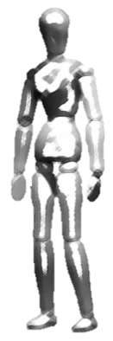
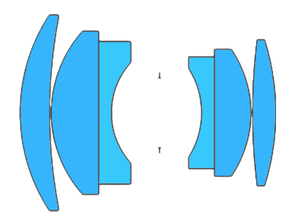
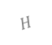
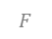
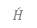
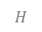
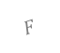
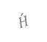
$$F$$
$$\acute{H}$$
$$H$$
Optical axis
Sensor
Plane of Sharp Focus (PoSF)
Depth of Field (DOF)
(a)
Depth of Field (DOF)
$$F$$
$$\acute{H}$$
$$H$$
Sensor
Optical axis
Plane of sharp focus (PoSF)
(b)

Slide 2
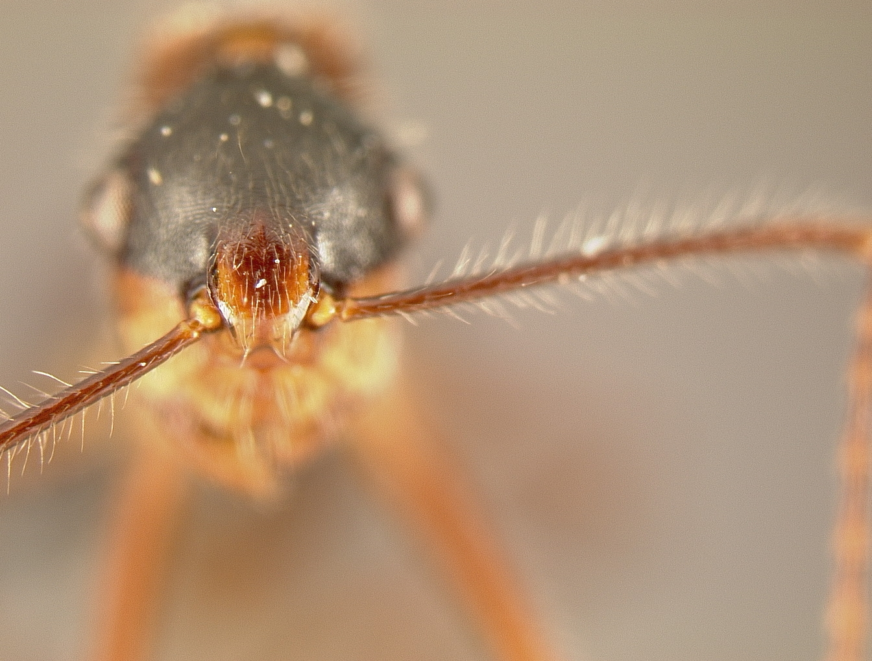
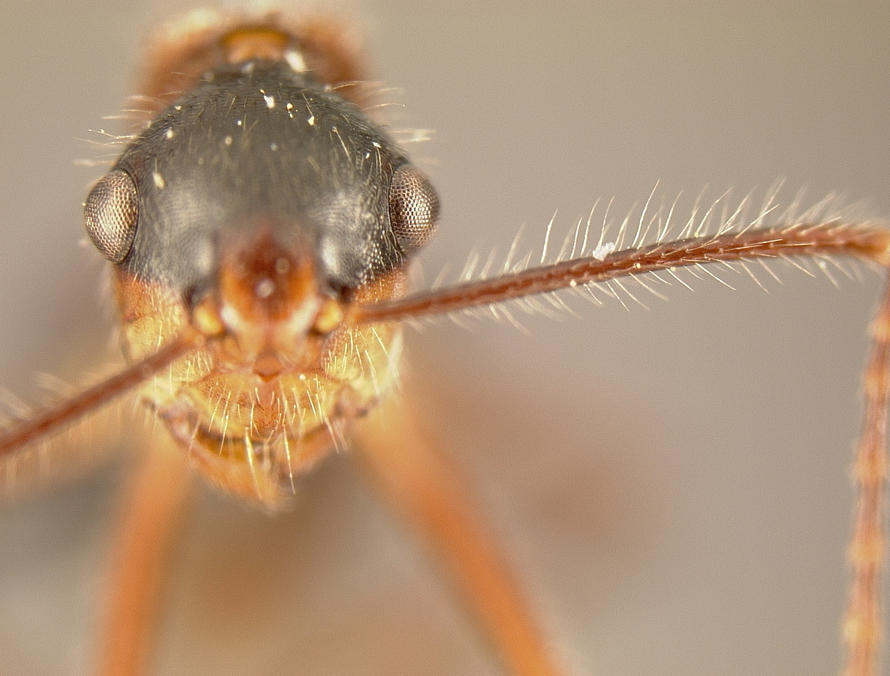
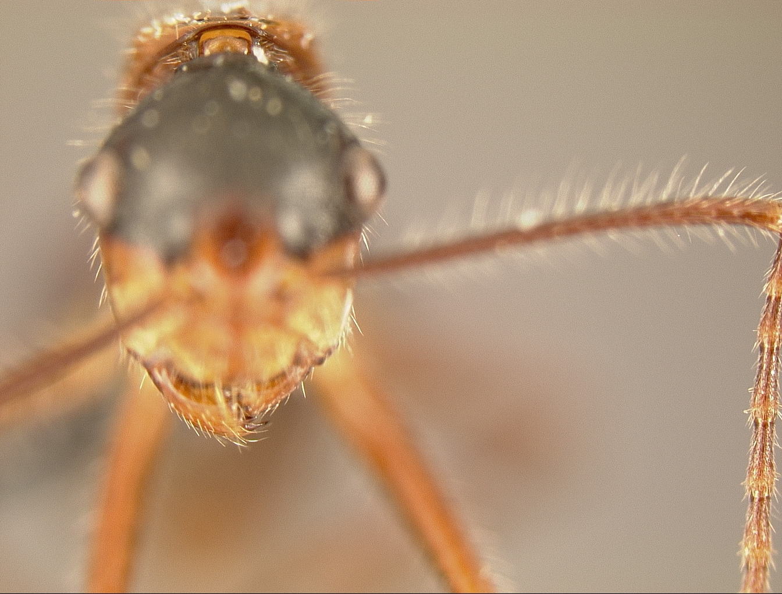
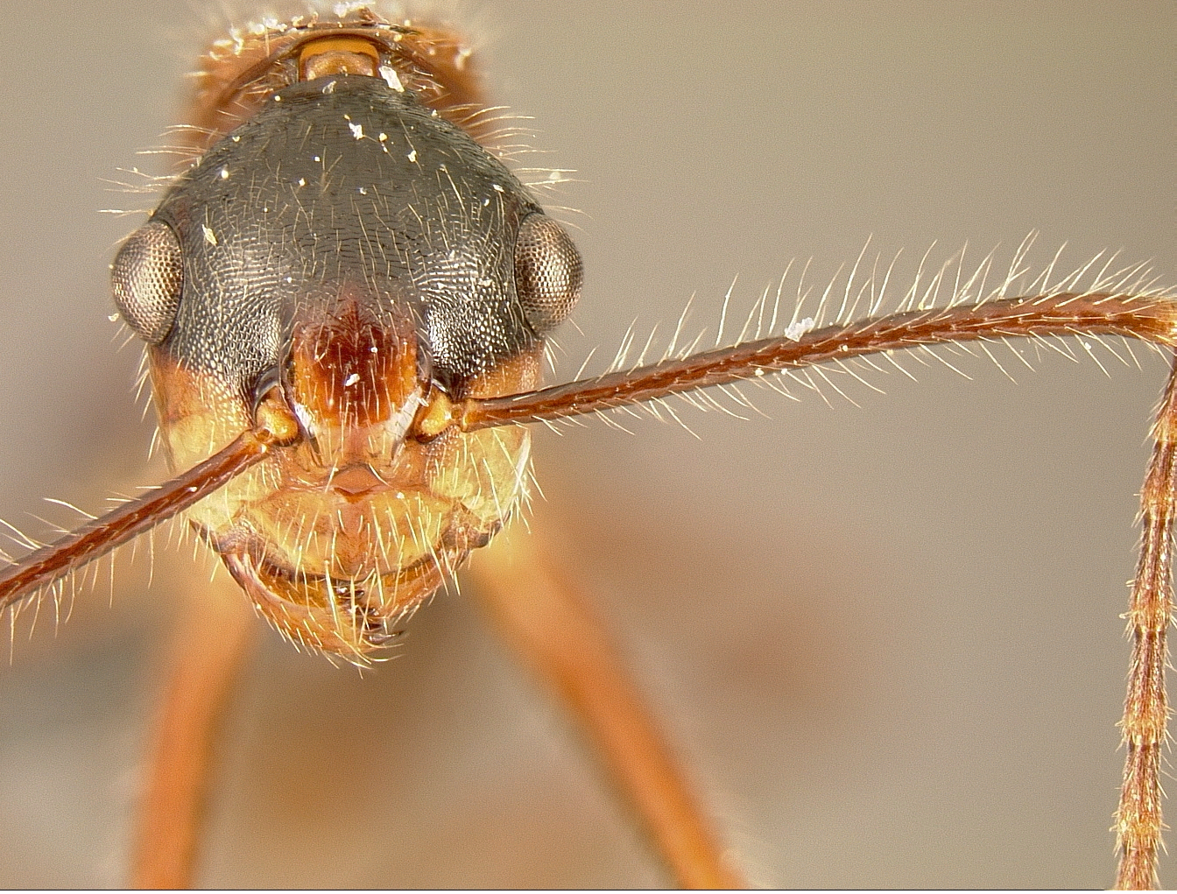

Slide 4
$$F$$
$$\acute{H}$$
$$H$$
4
3
2
1
4
…
1
Optical axis
Sensor translation
Plane of Sharp Focus
Depth of field
2
1
1
2
3
3
4
4
z-axis
Lens rotation
Plane of Sharp Focus
Depth of field

Slide 5
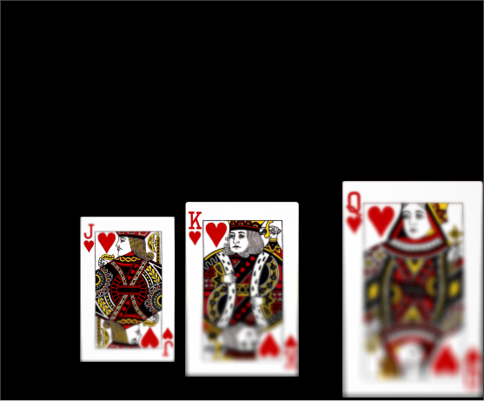



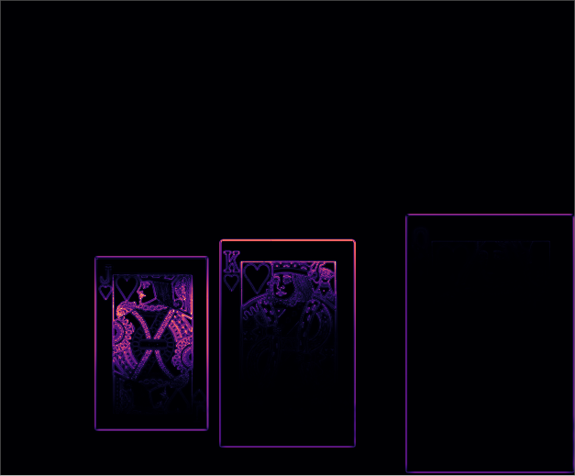
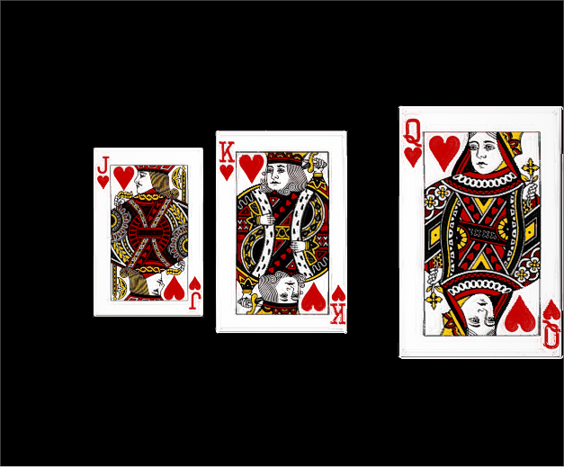
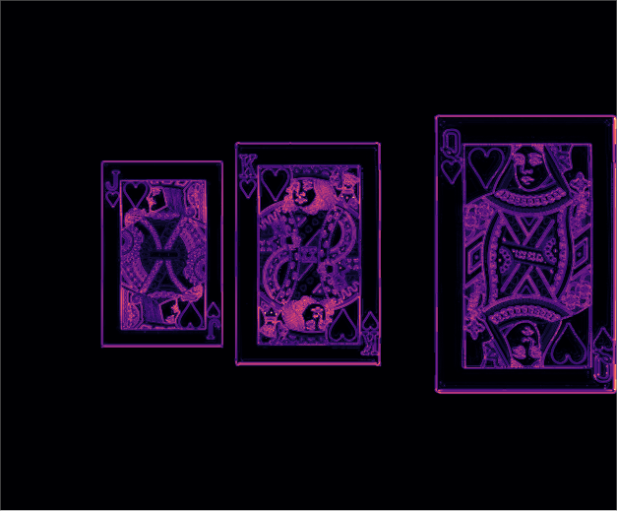
Setup of simulation in Zemax
Paraxial thick-lens model with spherical aberration;
$f$ = 24 mm, F/2.5, $d$*= 8 mm
Lens ($m_{p}=1$)
Sensor image 1/13
Lens tilt, $α=−8^{o}$
1/2
64 mm
Sensor plane
$z$-axis
(b)
6 x 5 sq. mm, 1.78 $μm$
Focus measure (LoG)
89 mm
13 tilts
between -8° & +8°
200 mm
200 mm
800 mm
1/2
(a)
* $d$ is the separation between the pupils.
(c)
Composite image
Focus measure (LoG) of the composite image
1/2
1/2
(d)
(e)

Slide 6
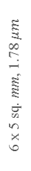
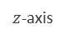
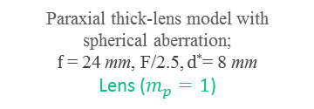
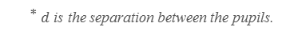
Paraxial thick-lens model with spherical aberration;
$f$ = 24 mm, F/2.5, $d$*= 8 mm
Lens ($m_{p}=1$)
64 mm
$z$-axis
Sensor plane
6 x 5 sq. mm, 1.78 $μm$
89 mm
13 tilts
between -8° & +8°
200 mm
200 mm
800 mm
* $d$ is the separation between the pupils.

Slide 7
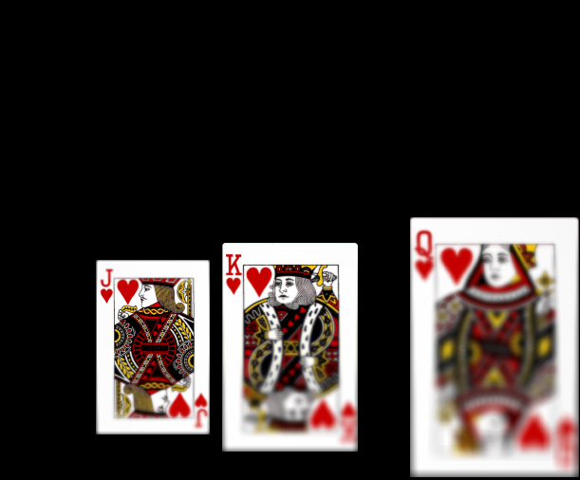
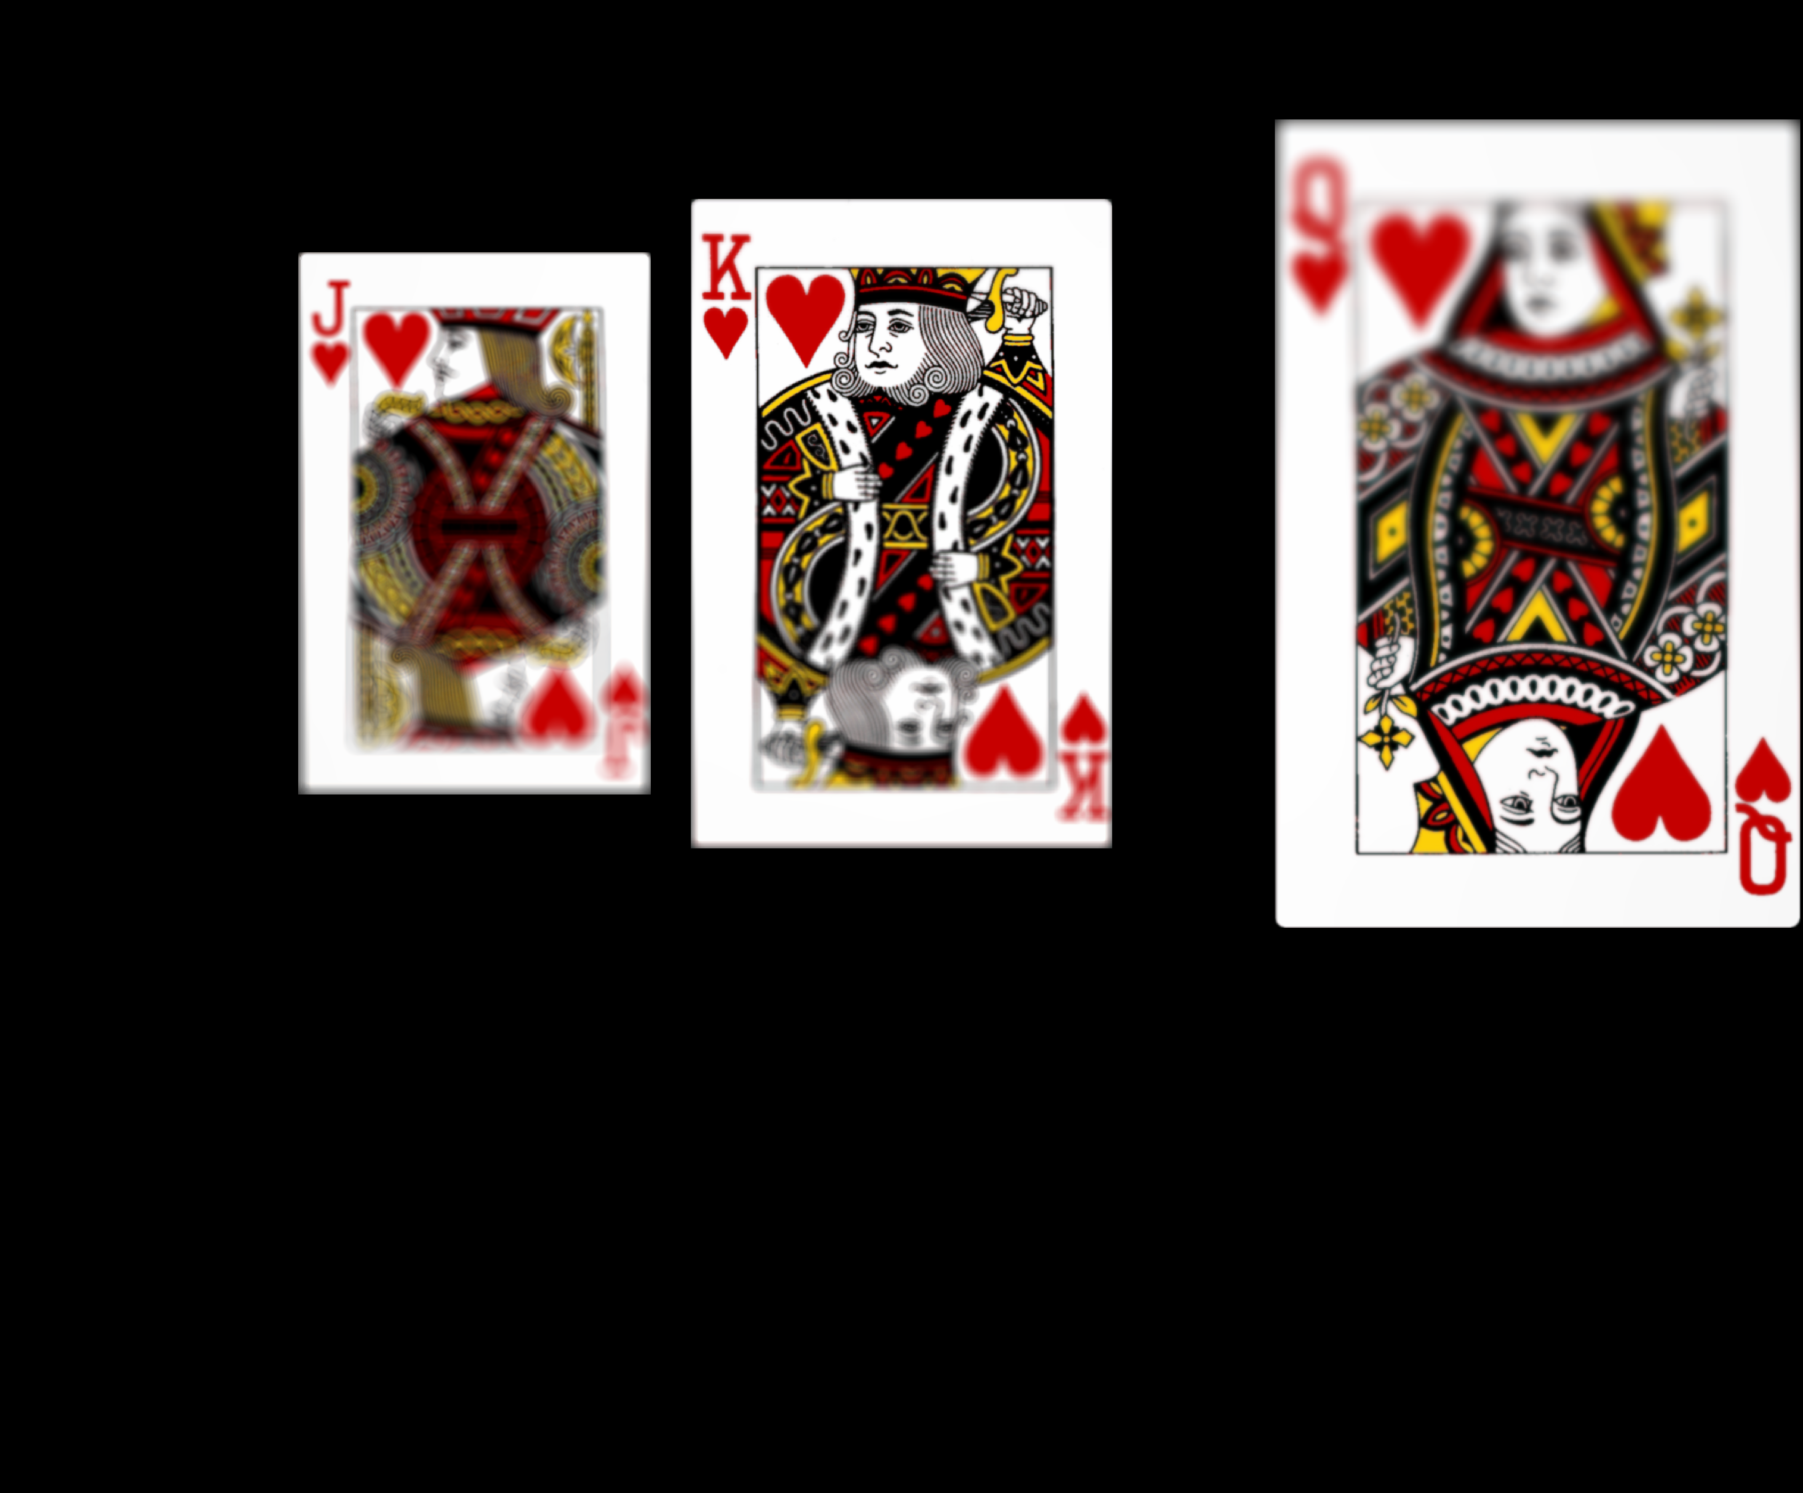
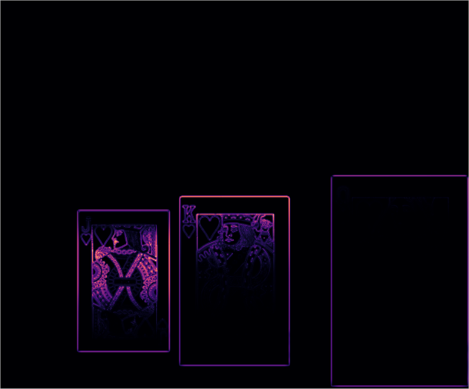
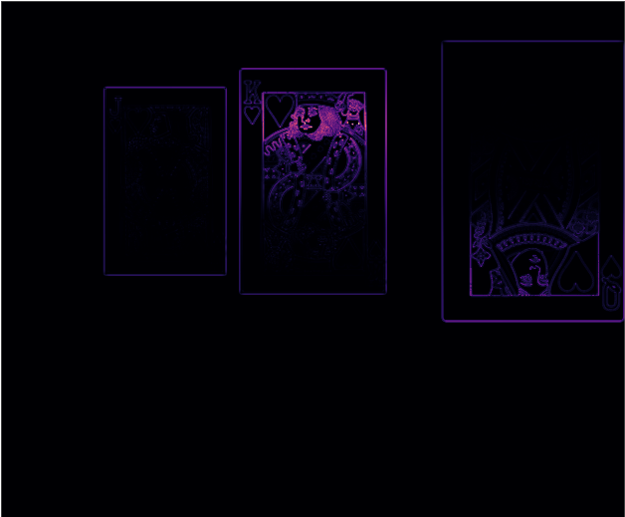


000.png, 010.png
Sensor image 1/13 ($α$=-8°)
Sensor image 11/13 ($α$=5.33°)
1/2
1/2
(a)
(c)
Focus measure (Laplacian of Gaussian)
Focus measure (Laplacian of Gaussian)
1/2
1/2
(b)
(d)

Slide 8
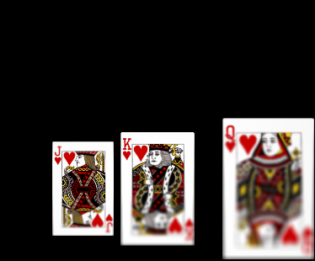
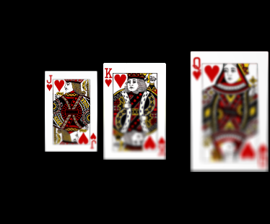
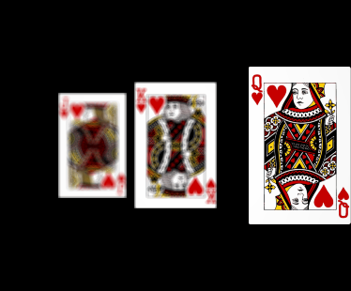
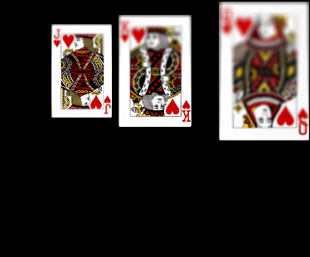
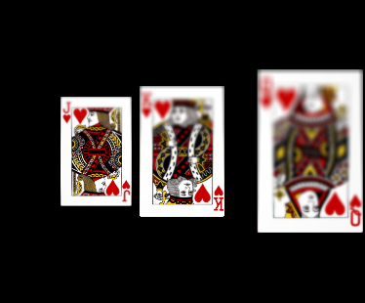
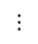
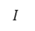
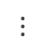

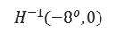

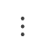

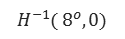
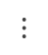
Sensor image ($α$=-8°)
Registered image
$$H_{ }^{−1}(−8^{o},0)$$
1/2
1/2
$$⋮$$
$$⋮$$
Sensor image ($α$=0°)
Registered image
1/2
$$I$$
1/2
$$⋮$$
$$⋮$$
1/2
$$H_{ }^{−1}( 8^{o},0)$$
1/2
Sensor image ($α$= 8°)
Registered image

Slide 9
Composite image
Focus measure (Laplacian of Gaussian)
1/2
1/2
(a)
(b)

